Slide 1



2024
BANA 4080
Customer Retention Analysis
Regork
12.10.2024

Slide 2

Purpose:
Utilize Data to Predict Churn Rates
6988 Customer
Phone and Internet Services
20 Variables, 1 Response
Notes:
predicting customer churn and identifying actionable strategies.
Key variables: demographics, services, billing, and customer status.

Slide 3
Data Preparation
Filtered out Incomplete Data, Tenure = 0
Transformed Status Variable
Machine Learning Models
MARS
Bagged Tree
Random Forest
Key Stat: ROC_AUC
Notes:
Receiver operating characteristic - Area Under Curve

Slide 4
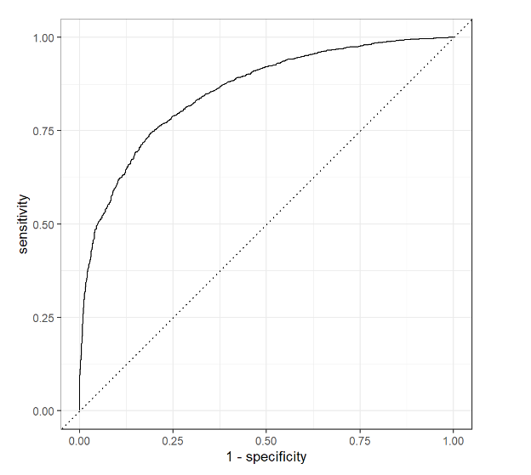
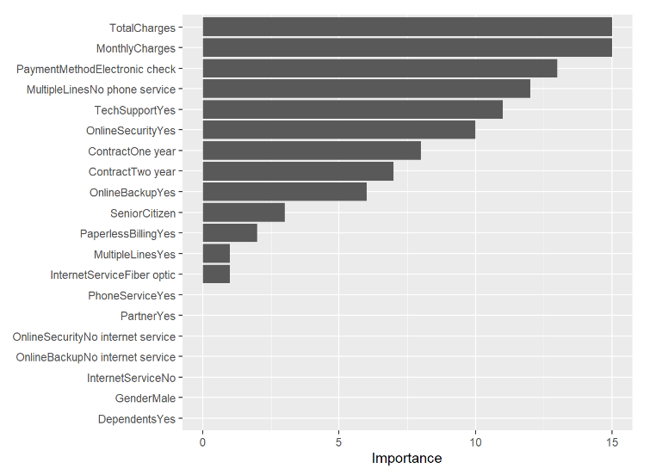
Best Model: MARS (excluding Tenure)
ROC_AUC: 85%
Key Features:
Total Charges
Monthly Charges
Payment Method (Electronic Check)
Tech Support (Yes)
Multiple Lines (No Phone Service)
Key Findings

Slide 5

Business Insights
Key Drivers of Churn:
High Monthly/Total Charges: Price sensitivity issues.
E-Check Payment Method: Associated with higher churn.
Tech Support Users: Likely reflecting dissatisfaction with service.
No Phone Service: Missed bundling opportunities.
Predicted Revenue Loss:
Estimated $136,540/month if no action is taken.

Slide 6
Recommendations
Price Incentives
Payment Support
Tech Support Revamp
Notes:
Bundling discounts for no-phone-service customers.
Temporary price reductions for high-risk customers.
Streamlined processes and educational outreach for E-Check users.
Incentives for switching to auto-pay via credit/debit cards.
Enhanced training and proactive customer outreach to resolve concerns.

Slide 7
Limitations
Data Scope: Limited to the provided dataset.
Excluded Variables: No geographic or competitor data included.
Qualitative Insights Missing: Lack of direct customer feedback.

Slide 8
Next Steps
Prices
Payment Methods
Market Analysis
Education and Method Incentives
Customer Feedback
Surveys about experience

